Slide 1
Machine Protection and Operation
Doug Curry
USPAS, January 2017

Slide 2
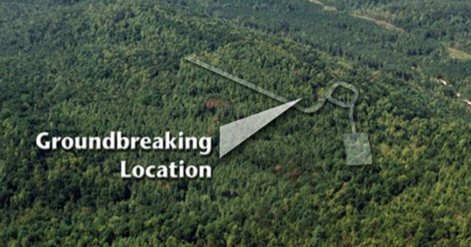
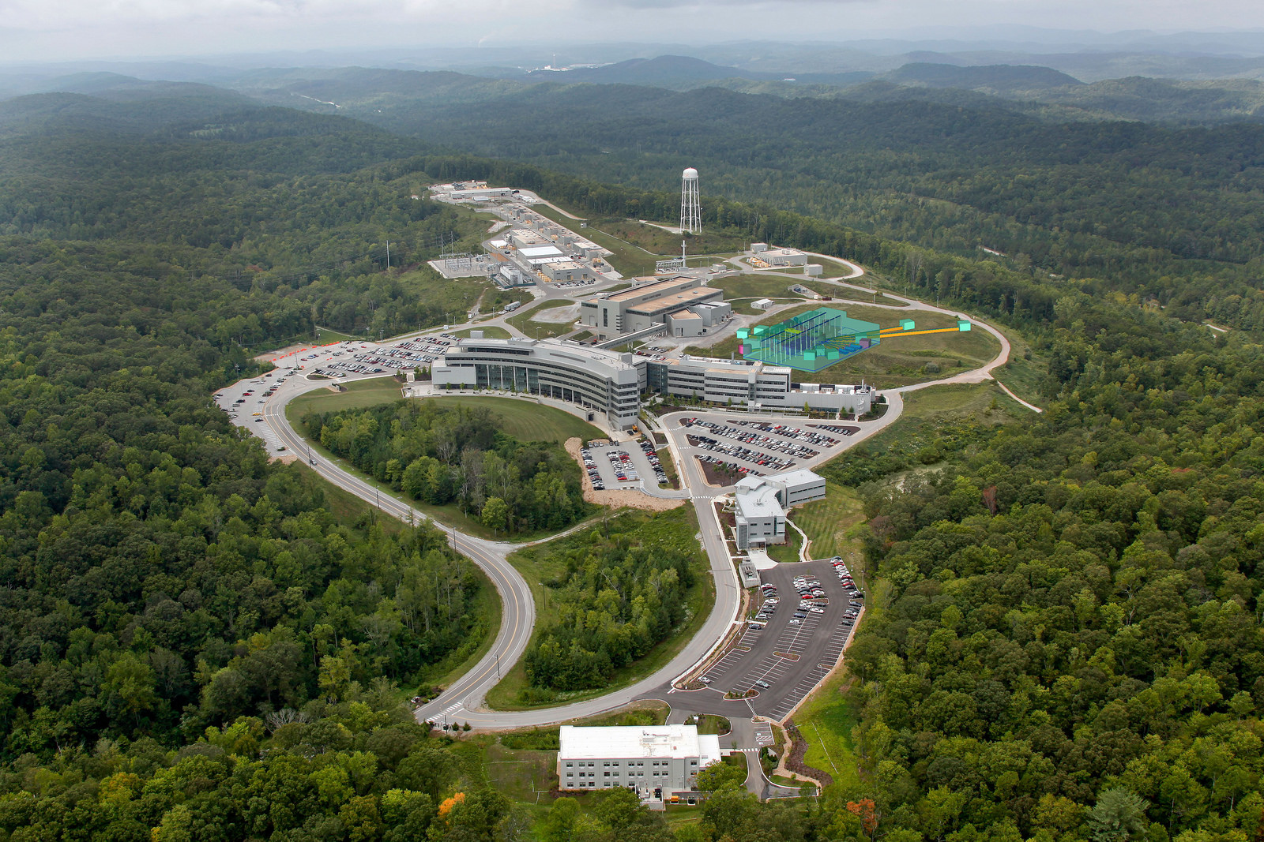
From Commissioning to Operations
FTS
STS

Slide 3
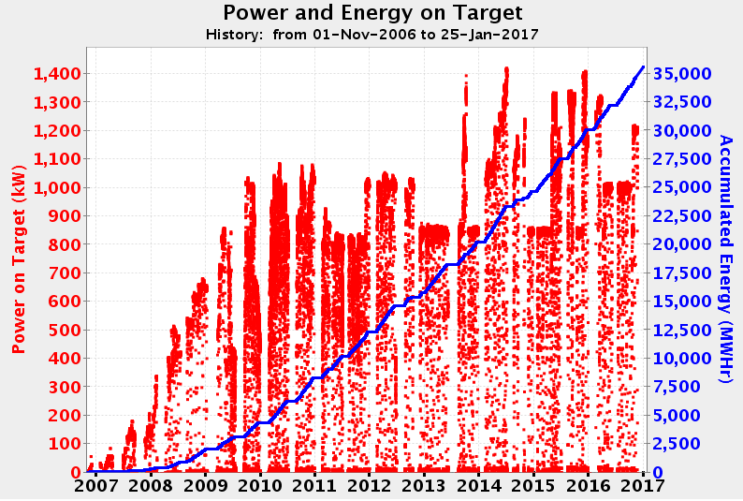
From Commissioning to Operations
1.4 GeV
~ 7 years
> 1.3 GeV
1.2 GeV Run Period
1.0 GeV Run Period

Slide 4
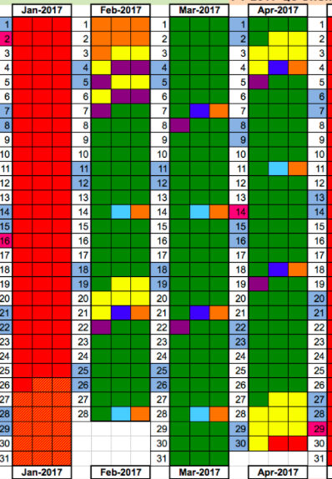
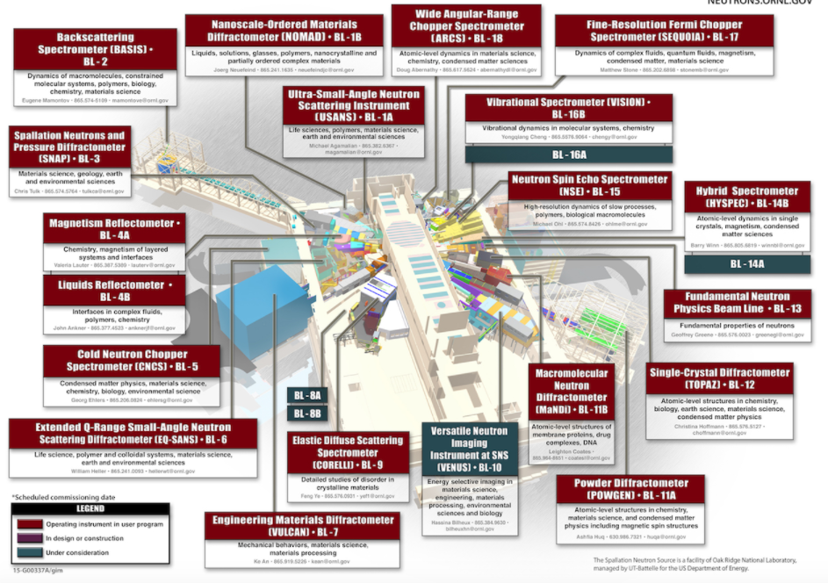
Machine availability
Disruption to the user program
Especially for short duration experiments
DOE expectation of their facilities
Categorize failures depending on experimental impacts
4 hours?
12 hours?
1 day??
Anticipate 1 week delay in machine startup
SNS Instrument layout

Slide 5
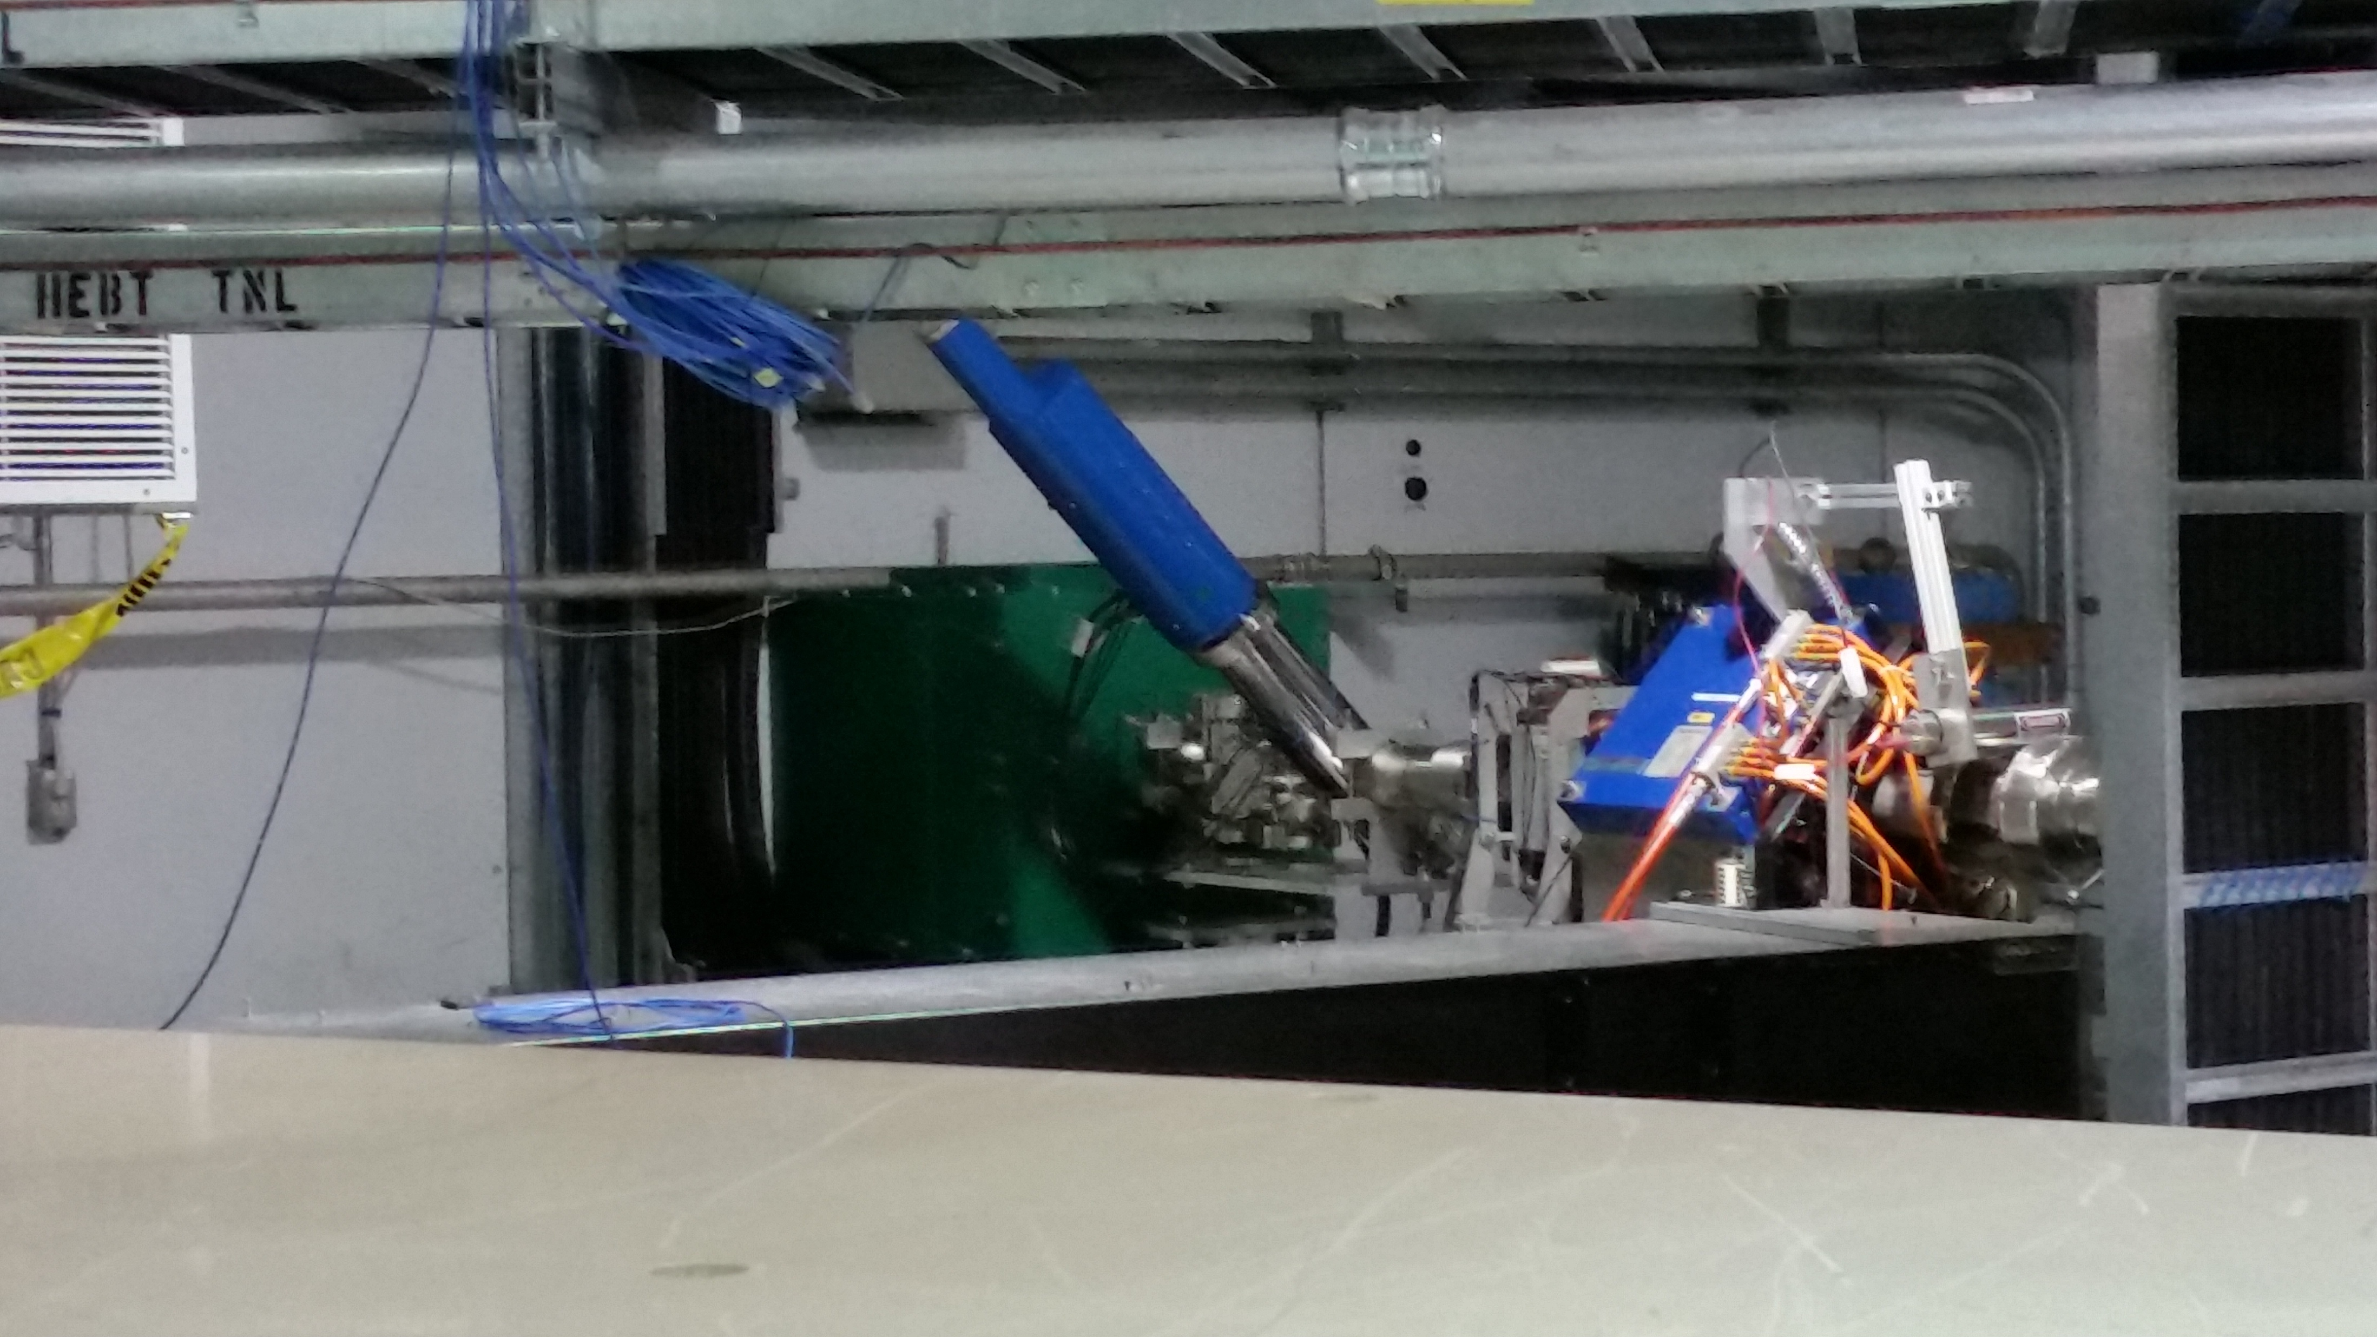
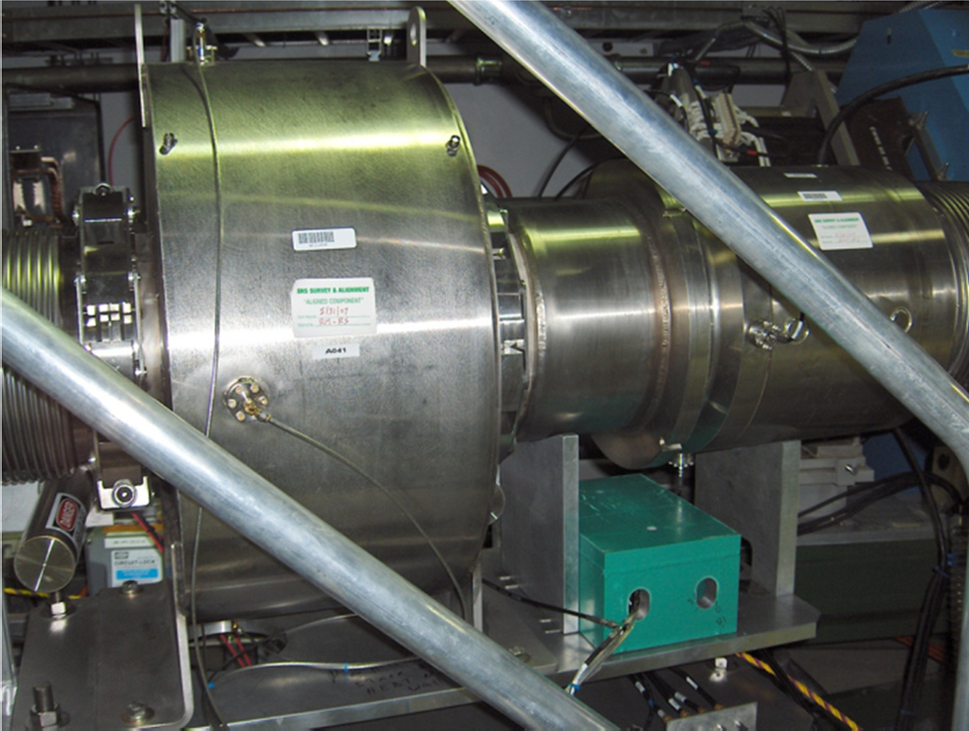
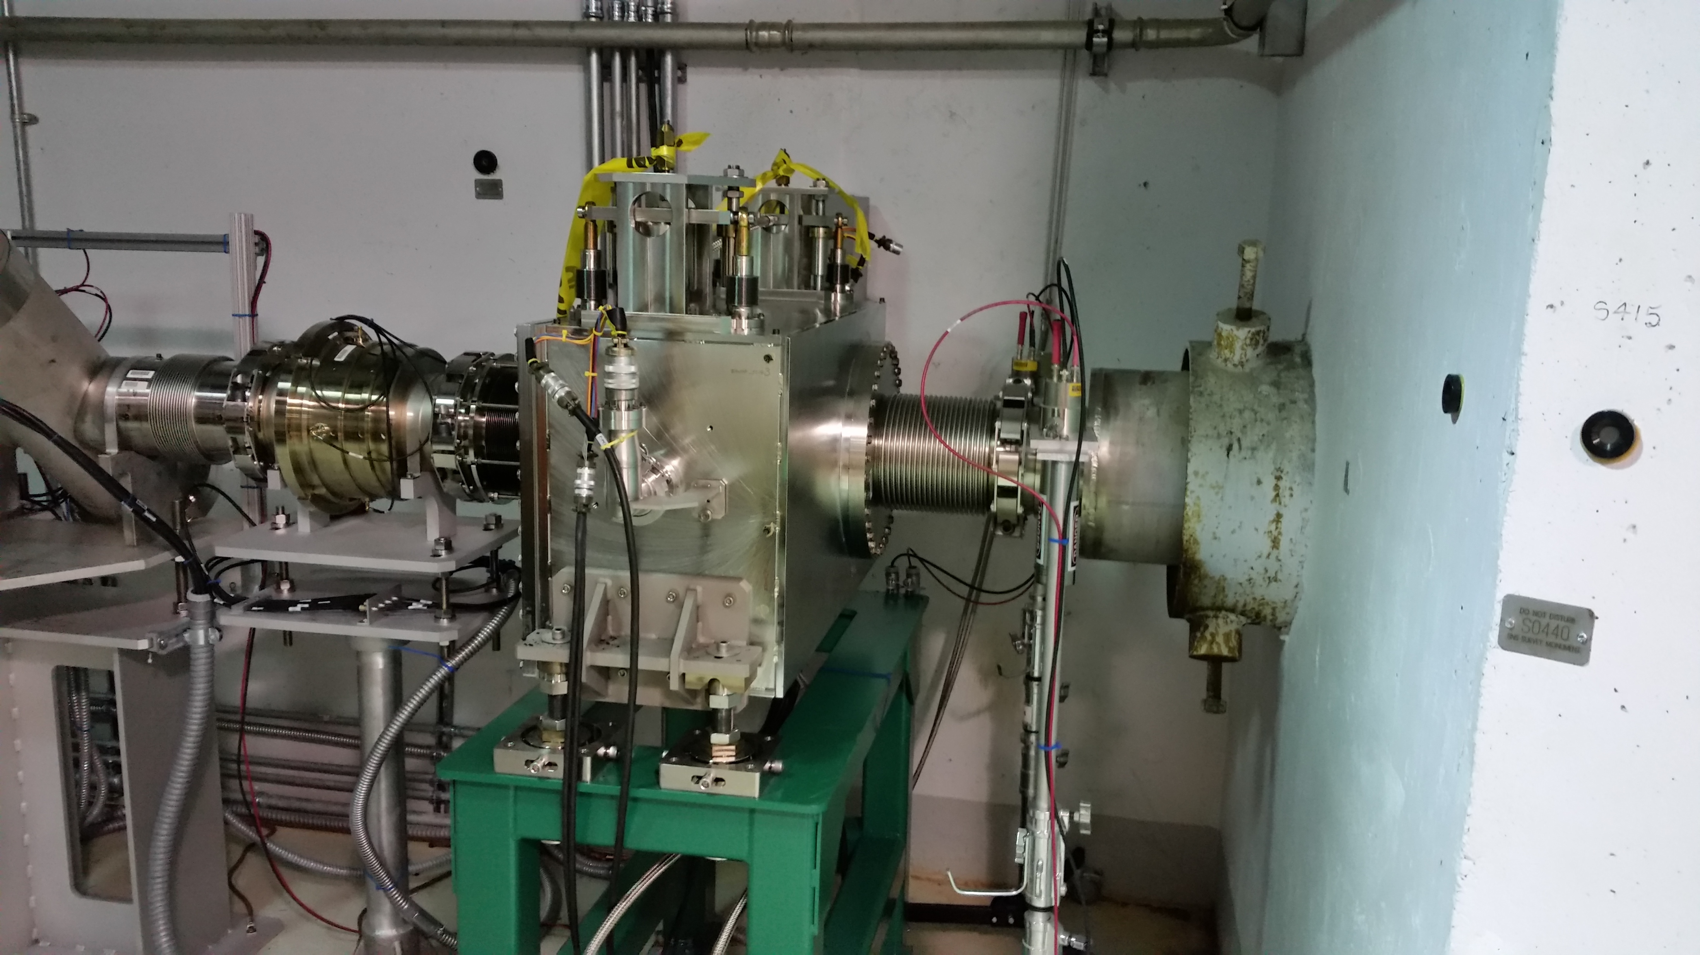
MPS Installations
Administration failure
highly unlikely
Cost/performance
Component cost versus MPS hardware costs
Commissioning to full production period
Risk
Likelihood of occurrence
Machine availability
Time to recover machine
Time to recover beam
No NCD at the Linac Dump
X
NCD and supporting hardware
$$$ - €€€
Foil Failure
Highly likely
✓
NCD installed at the
Extraction Dump

Slide 6
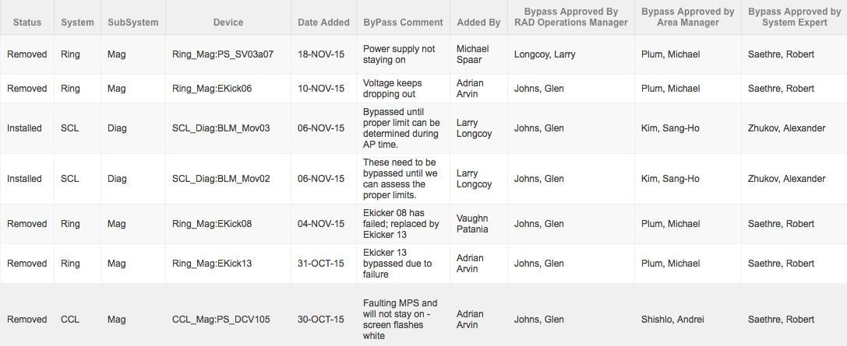
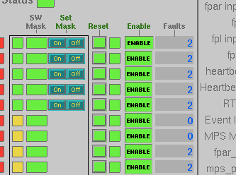
Masking interlocks
3 approvals required
3 level to approve an MPS bypass request
Some MPS interlocks bypasses must be enabled local at the hardware
Bypass log
Masking enabled
Masking disabled at the MPS hardware
MPS Screen

Slide 7
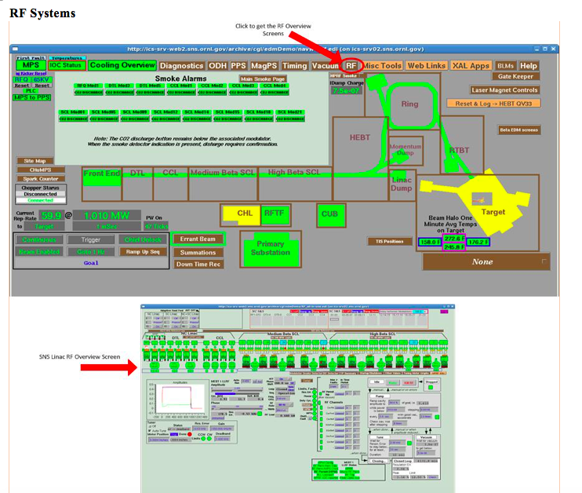
Administrative
MPS Interlock checks
SNS documented procedure
Completed at the end of every extended outage (2x/year)
Increasing to 3x per year
Fault each device locally one at a time to verify the integrity of the system
Takes about 1 week effort of combined time to go through all of the systems
> 1000 inputs
MPS ”fiber” link light measurements are performed every extended outage

Slide 8
Operational disruptions
> 8 hour downtime example
Software Interlocks wouldn’t work due to incorrect readbacks from power supply
Root cause
Contributing causes

Slide 9
Operating Metrics
Production hours, what we were supposed to do
Accelerator physics, what we actually did do
Production hours, what we actually did do
% availability during production period
% availability during accelerator physics
Accelerator physics, what we actually did do
Totals

Slide 10
Operating Metrics
Meeting is held weekly to discuss machine performance
Unscheduled downtime for the week, overview
Systems showing signs of degradation are discussed

Slide 11
Operating Metrics
Unscheduled downtime for the week, detailed

Slide 12
Operating Metrics
Current FY summary of downtime per group

Slide 13
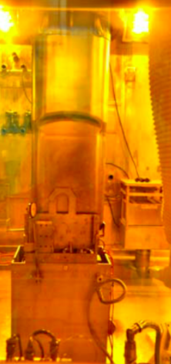
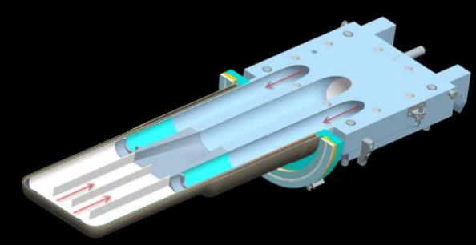
Sustaining Operations
Moving to 3 target changes per year to prevent disrupting the user program
Original expectations were 2 targets/year
Hg Channels

Slide 14
Sustaining Operations
Gas injection system online early FY18

